Slide 1
UTEP Student Employment Application Database
TEAM 9
LUIS MEDINA – ERICK AVALOS – GERMAN VIEZCAS – KEVIN OBREGON

Slide 2

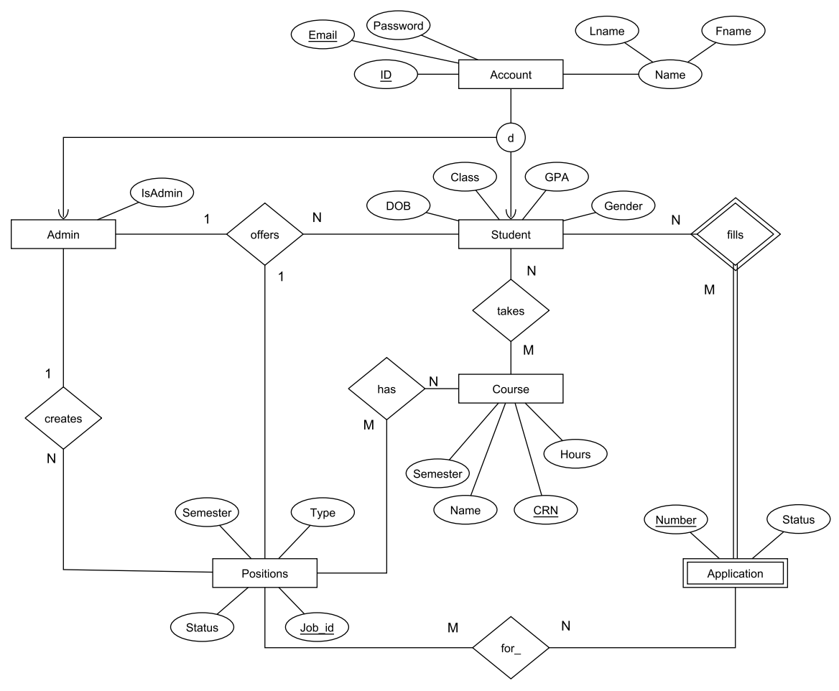
ENTITY-RELATIONSHIP DIAGRAM

Slide 3
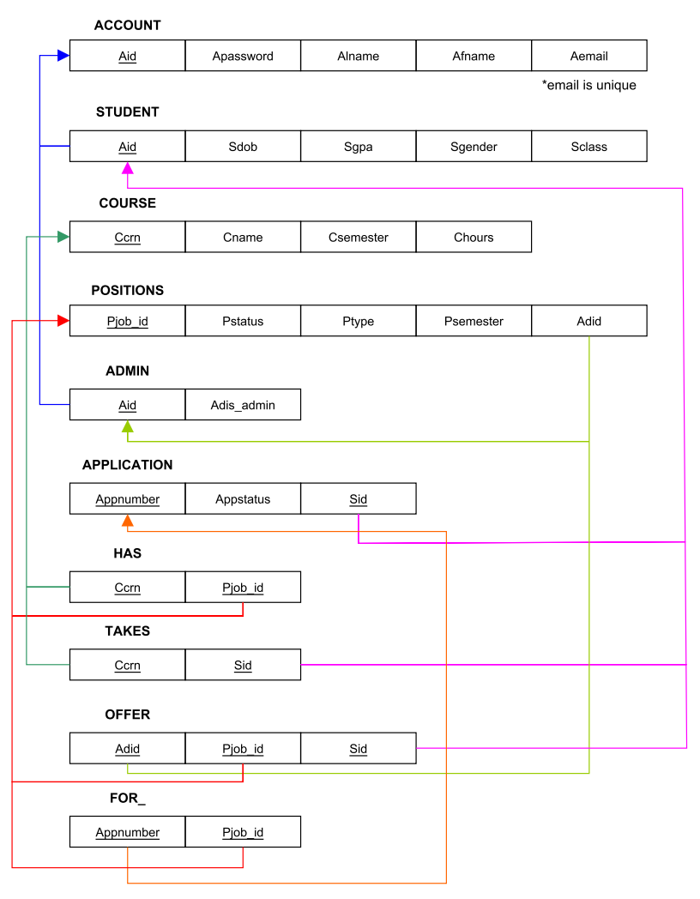
RELATIONAL MODEL

Slide 4
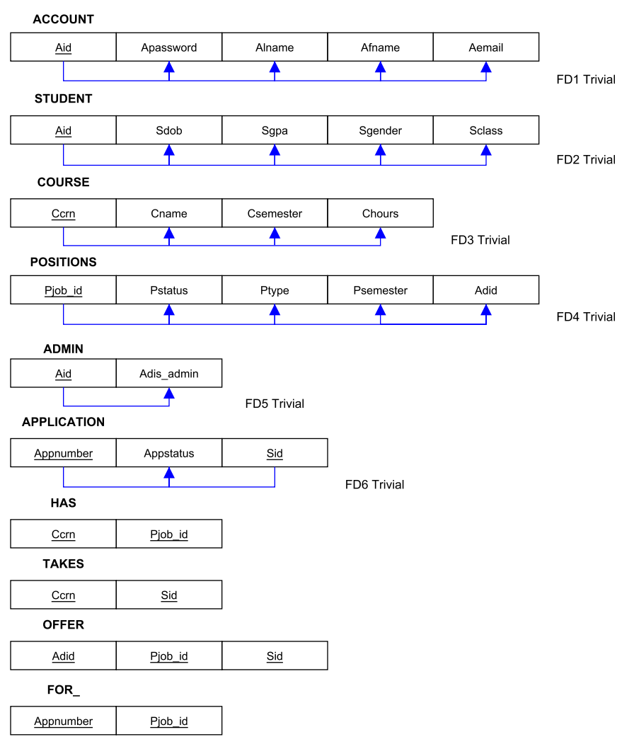
NORMALIZED SCHEMA

Slide 5
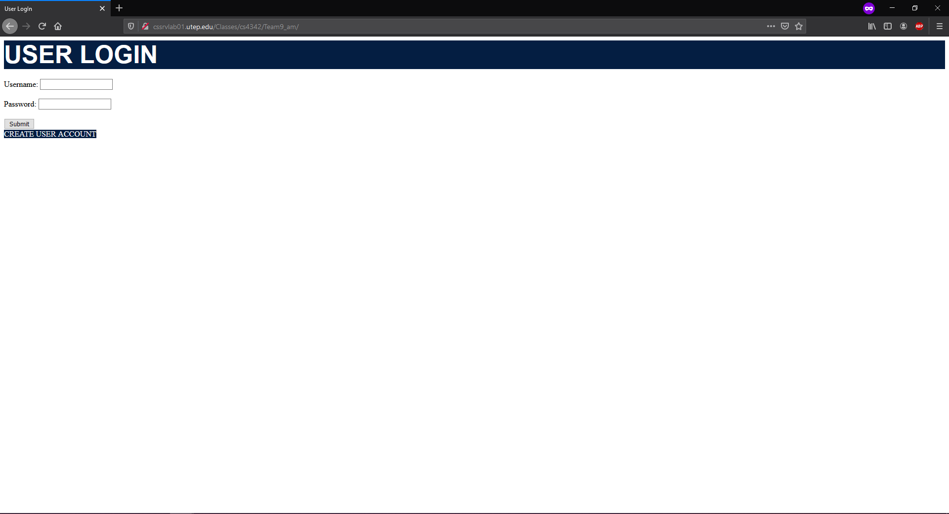
GUI – How it all comes together

Slide 6
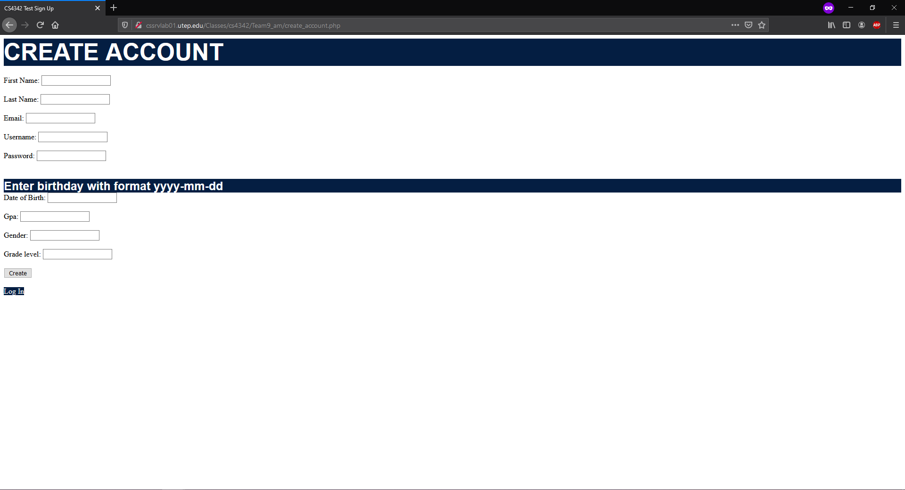
GUI – Account Creation

Slide 7
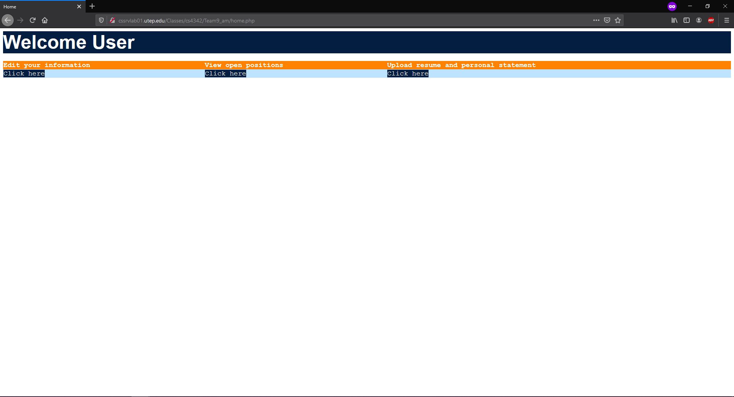
GUI – Student Home Page

Slide 8
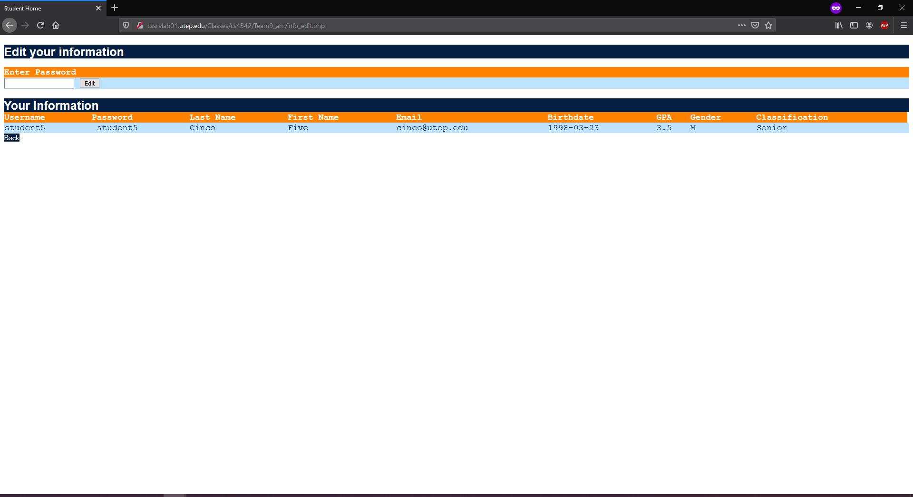
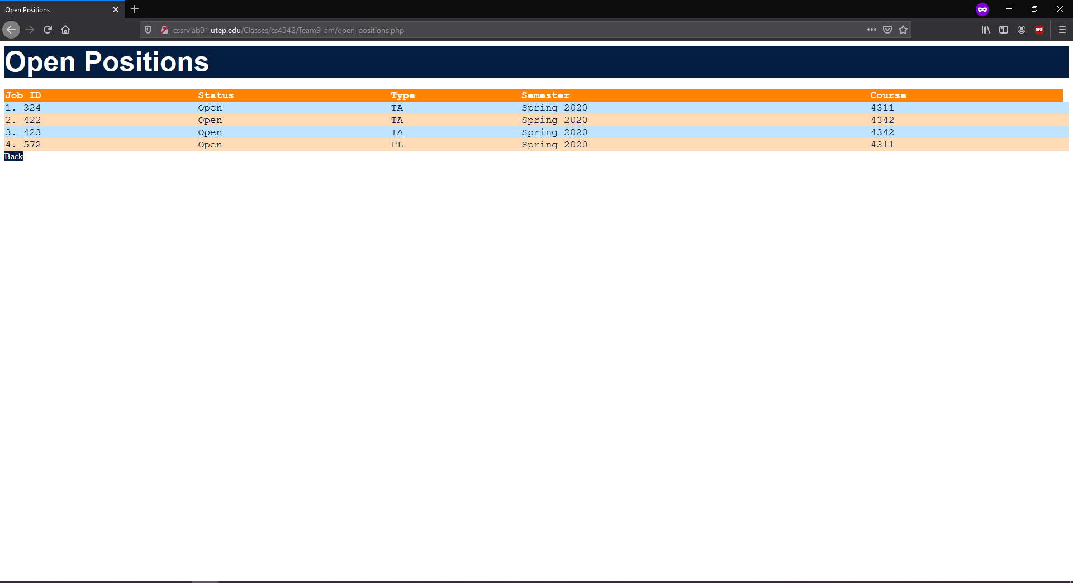
GUI – Student Info/Position Search

Slide 9
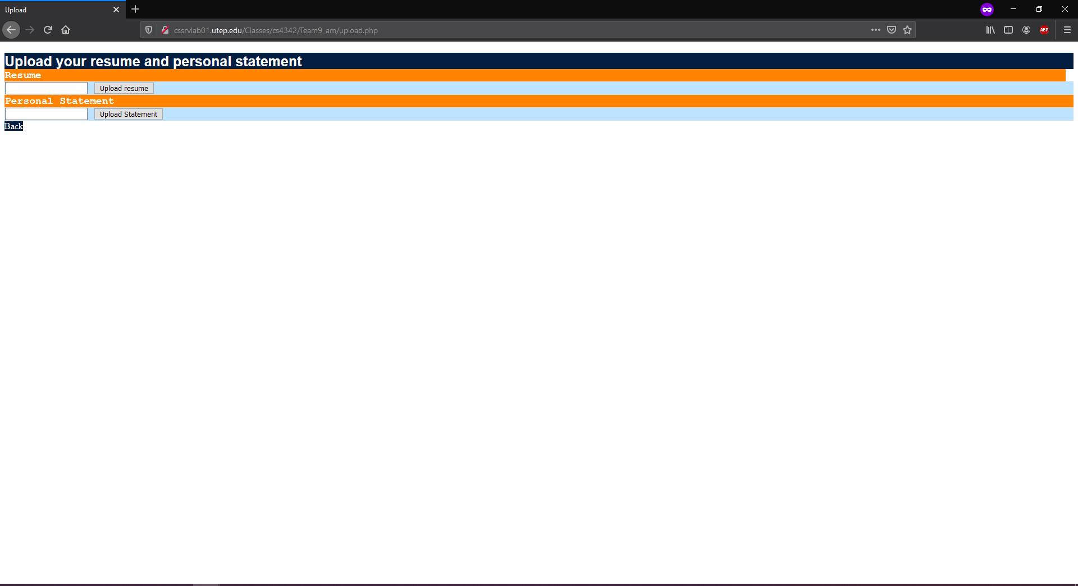
GUI – Student Doc Attachment

Slide 10
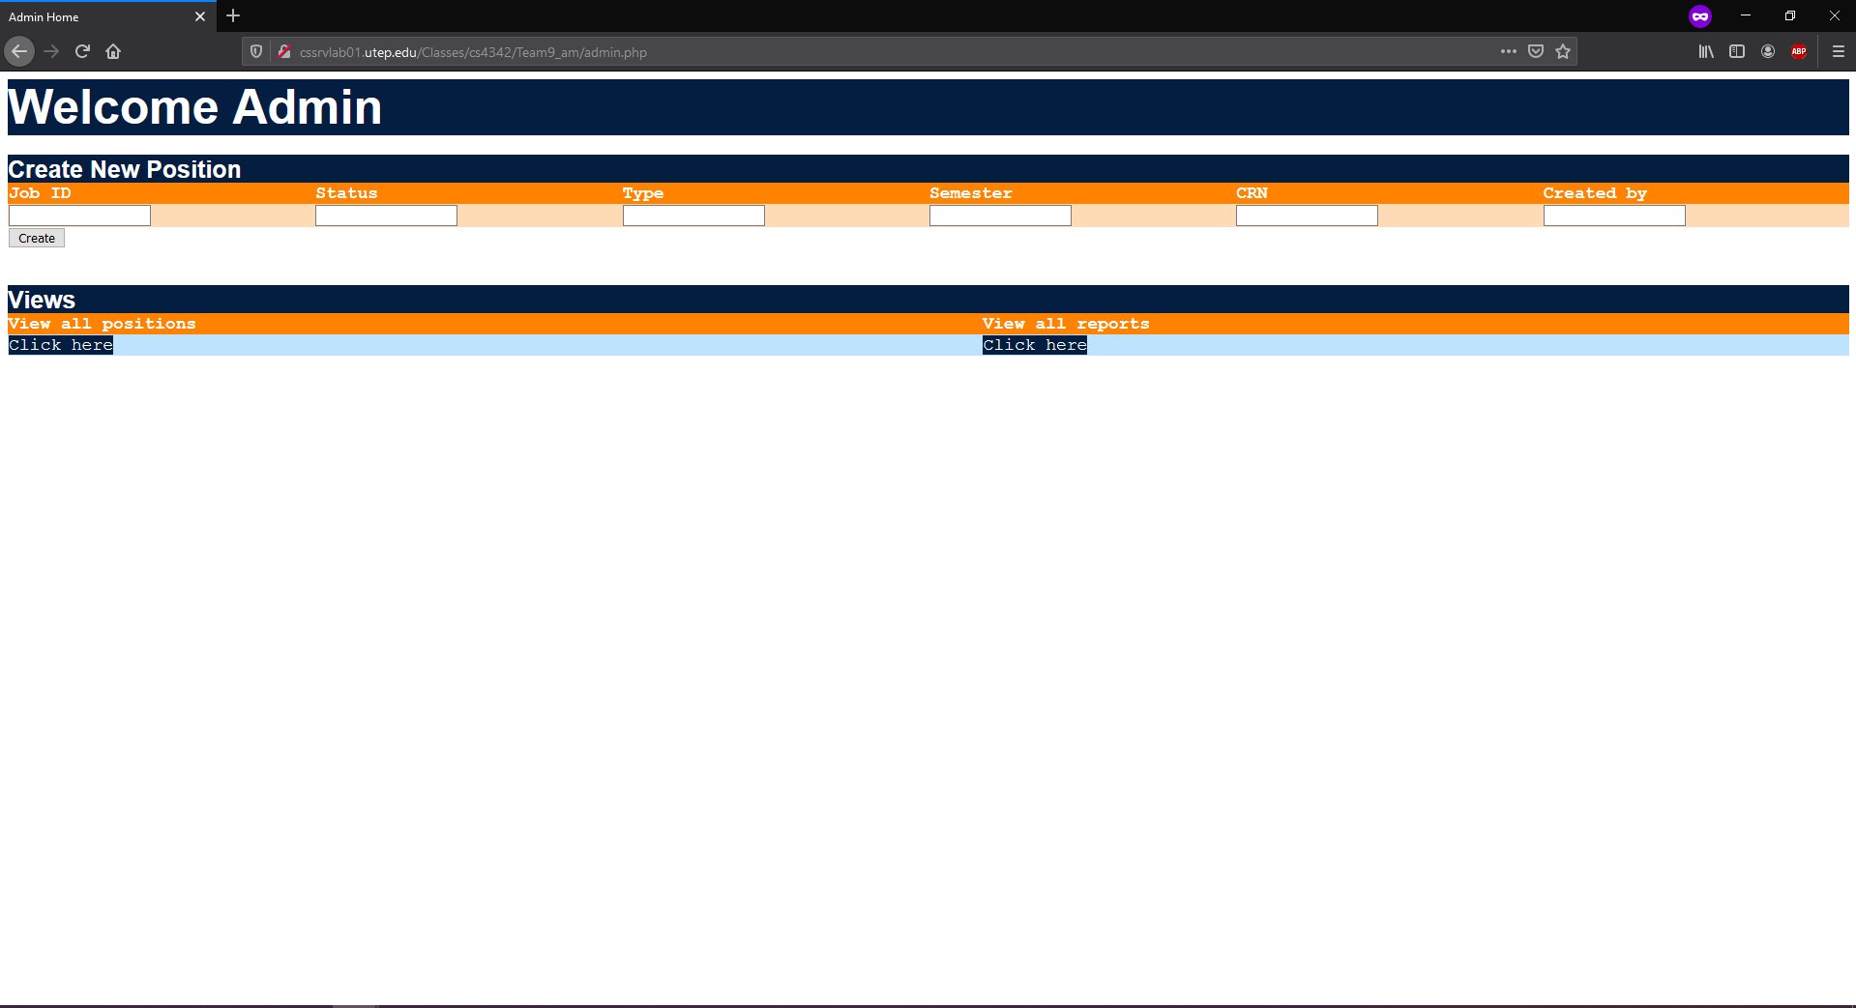
GUI – Admin Home Page

Slide 11
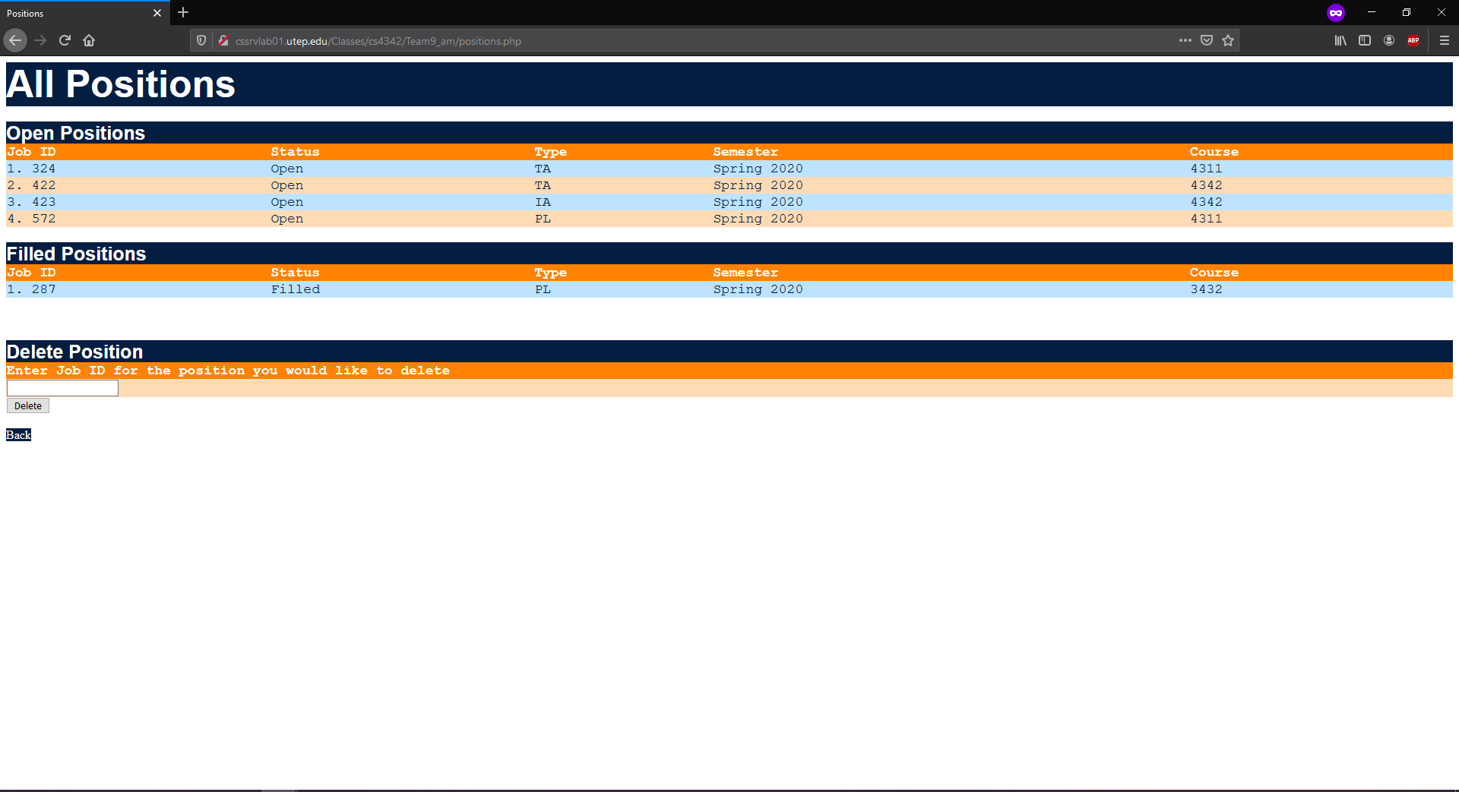
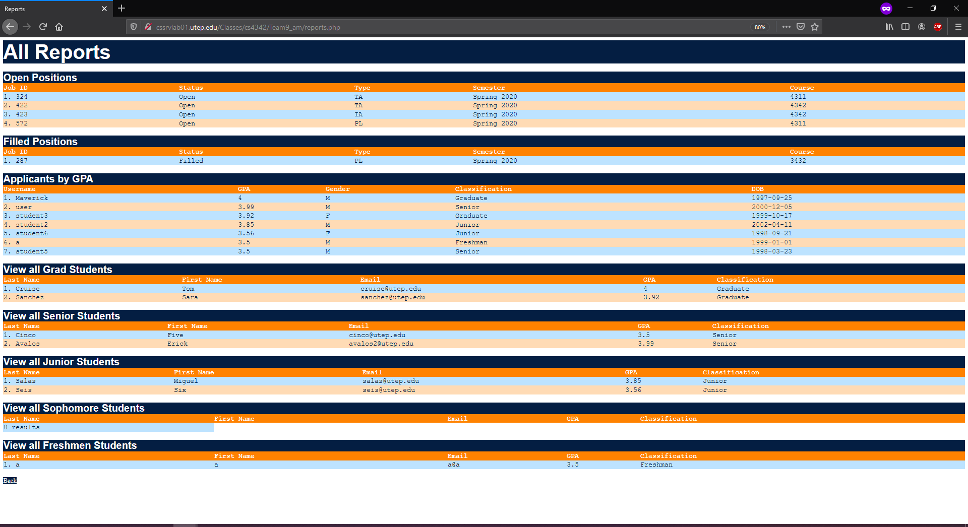
GUI – Admin Home Page

Slide 12
The End – Any Questions?

